Slide 1
Capstone
Use Case Exploration
IOS Team

Slide 2
Recap
Requirements gathering
Use case documenting
Initial Prototype and app mock up
Use case improvement
Siri dictation
Map integration
API integration

Slide 3
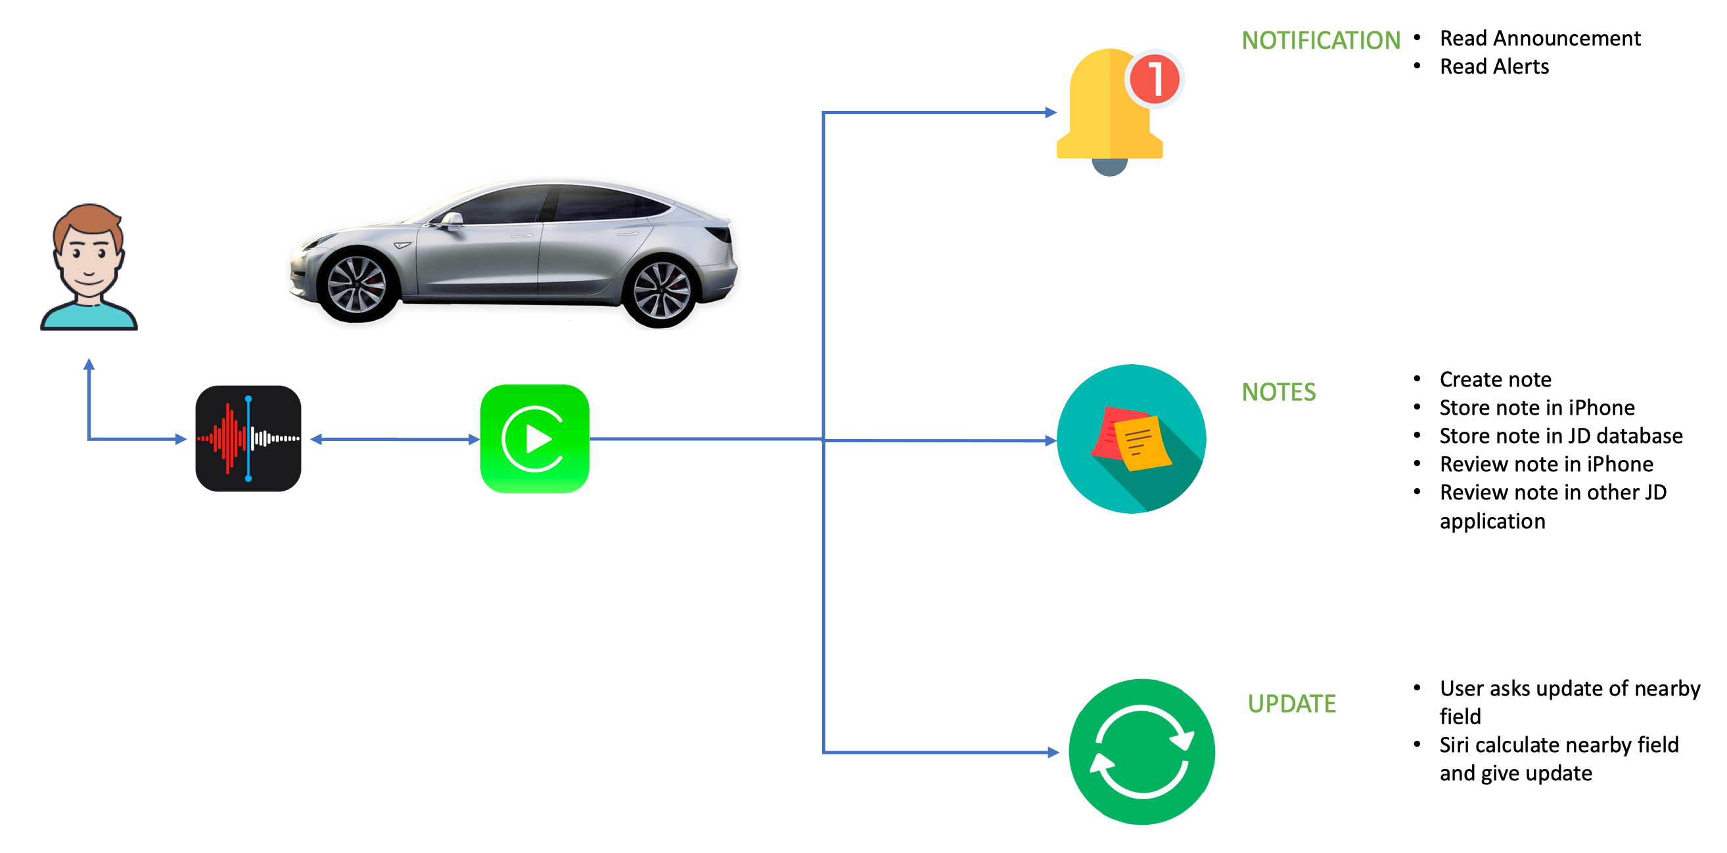
Use Cases

Slide 4
Use Cases
Get nearby fields updates since the last visit
Take a note
Hear previous notes
Notifications

Slide 5
Get nearby field updates since last visit
Context: The user is driving the car nearby his/her fields and wants to be updated about the current situation of his/her organizations to be able to react quickly by examining the field himself/herself immediately if he/she was nearby or call someone else responsible to react.

Slide 6
Take a note
Context: The user is driving nearby his/her strawberries field, he notices that the strawberries are Orange!! and would like to add a note to remind himself to call the agronomist to examine the field".
Alternative: the user wants to create a general note about the organization.

Slide 7
Read a note
Context: The user is driving by the nearby field and he/she wants to hear the previous notes created about the field, so he/she would be reminded of the previous important observations.
Alternative: the user wants to hear general notes that he created yesterday (not related to nearby field) serving as a general reminder of the work that has to be done today.

Slide 8
Notifications
Context: The user is driving his car to work or vacation and still wants to be notified about any critical situation (Severity of the notification: High) regarding his/her organization to be able to react quickly by examining the field by himself/herself immediately if he/she was nearby or call someone else responsible to react.

Slide 9
Implementation (iOS)
Log in Screen
Dashboard
Navigation menu
Create Notes
Updates since the last visit

Slide 10
Implementation (navigation)
Apple maps integration
Current location
Field boundaries

Slide 11
Implementation (API)
Frameworks integration
JDServices
AFNetworking
SBJson5
Bridge method

Slide 12
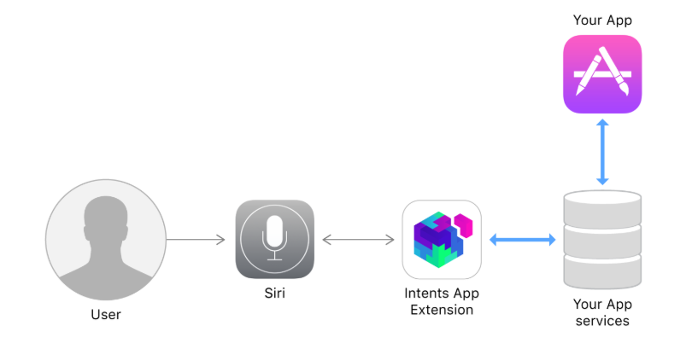
Implementation (Siri)
Custom Intents
https://developer.apple.com/documentation/sirikit

Slide 13
Current development plan
}

Slide 14
Thank you!

